Slide 1
HTML & CSS

Slide 2
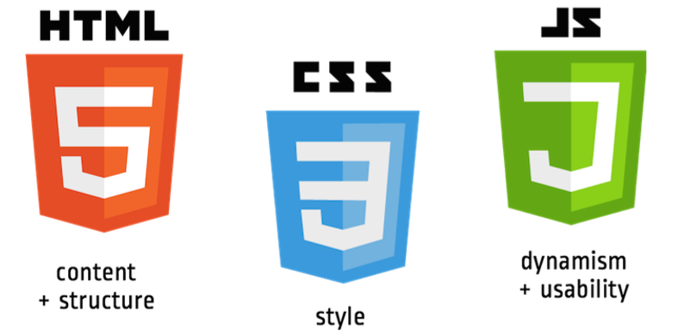
Front-end languages
The languages your browser speaks

Slide 3
HTML Basics

Slide 4
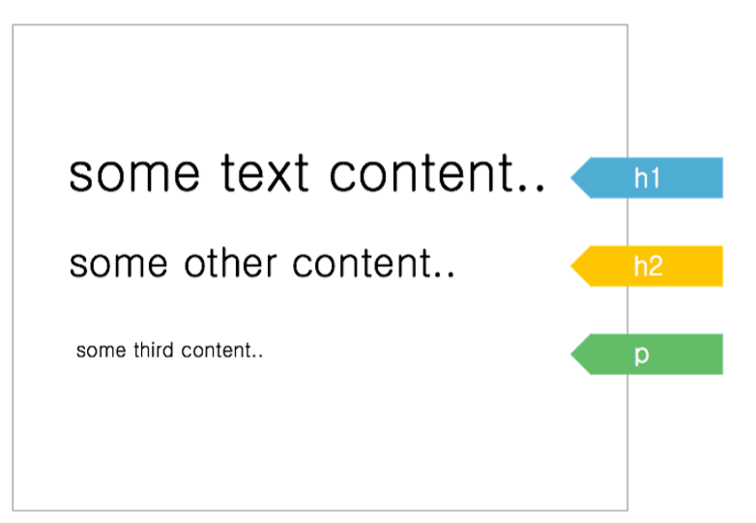
HTML
It's a markup language (== structure)
HTML tags help you identify content, and browser default styles will apply

Slide 5
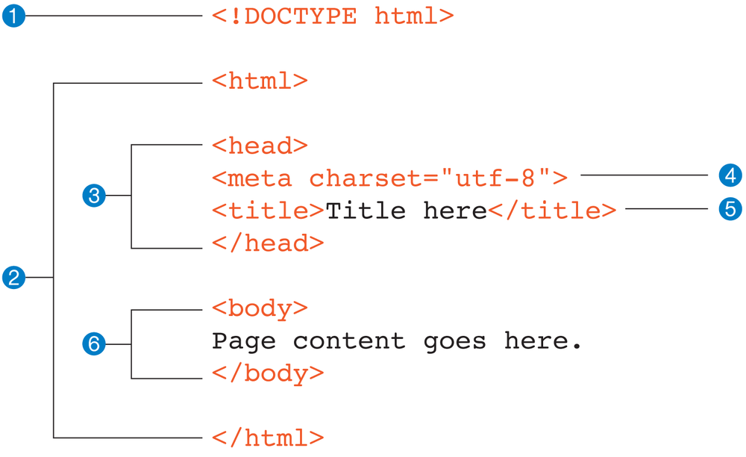
Page Structure
Document type declaration, tells the browser that you are using HTML5
Contains the entire web page.The html element is also called the root element
The head contains descriptive information about the document, such as the title, the style sheets, scripts, and other “meta” information
A meta element can be used to provide all sorts of information
Contents of the title element appear in the browser title bar
The body element contains everything that we want to show up in the browser window.

Slide 6
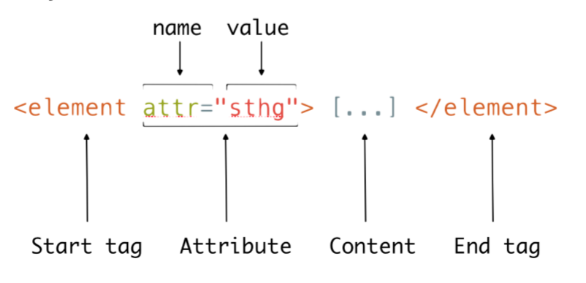
Basic Syntax

Slide 7
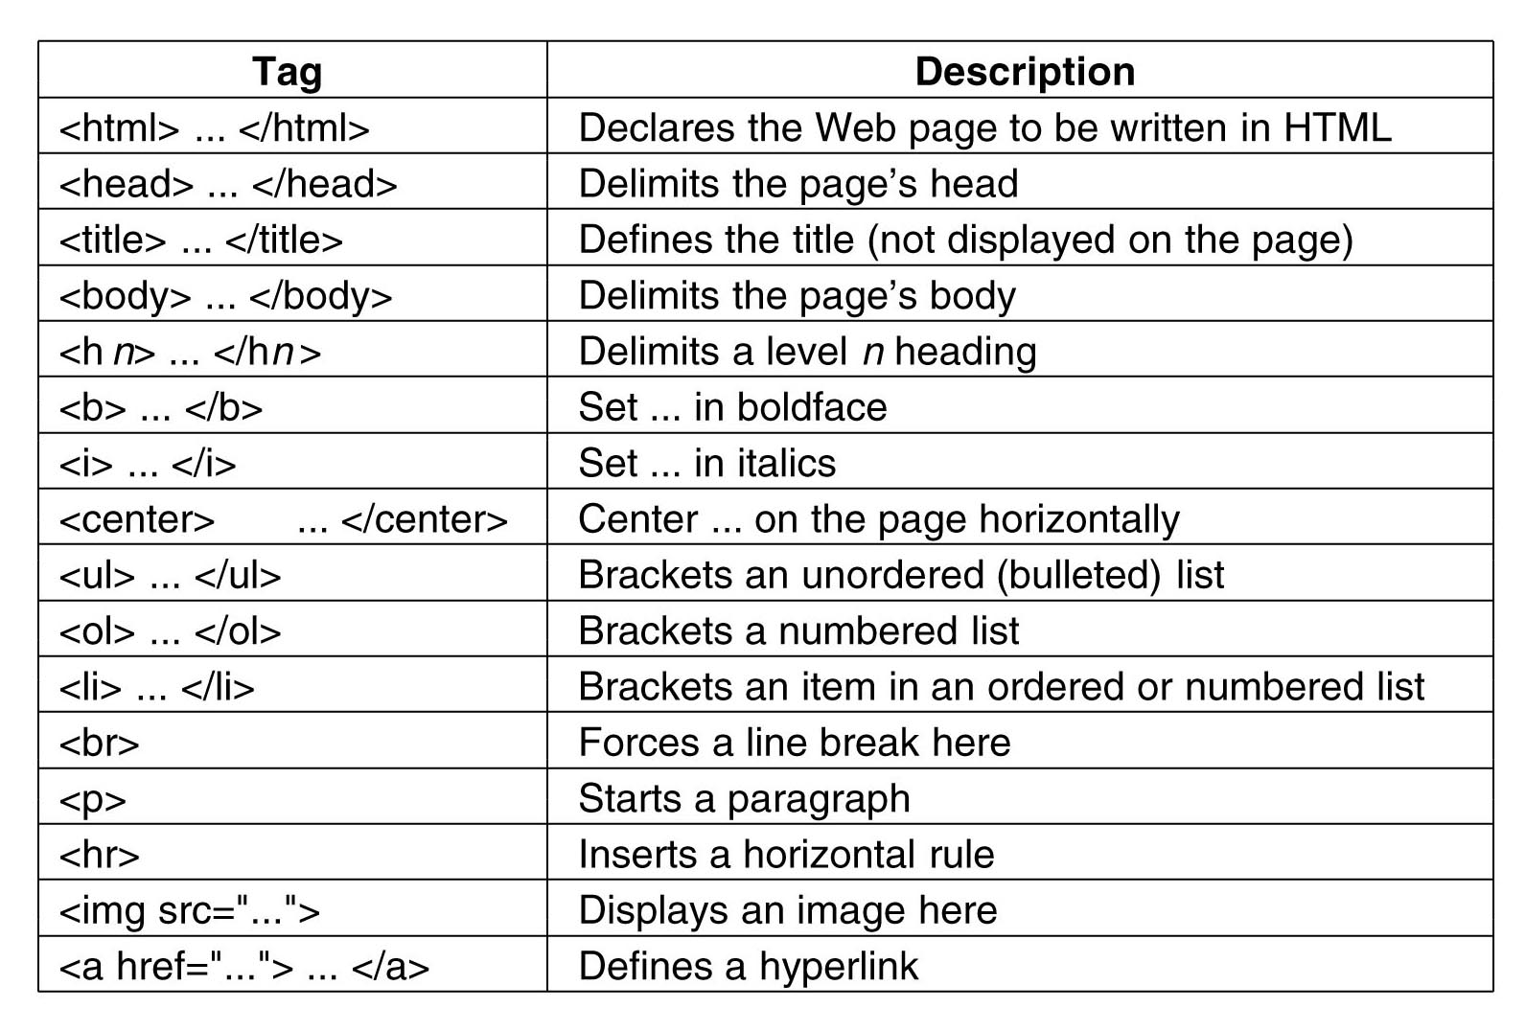
Basic Tags List

Slide 8
HTML - Quizz
<a href="http://innovationvillage.co.ug/" target="_blank">
Innovation Village
</a>
What is the name of the tag?
What is the content?
What are the 2 attributes (name and value)?

Slide 9
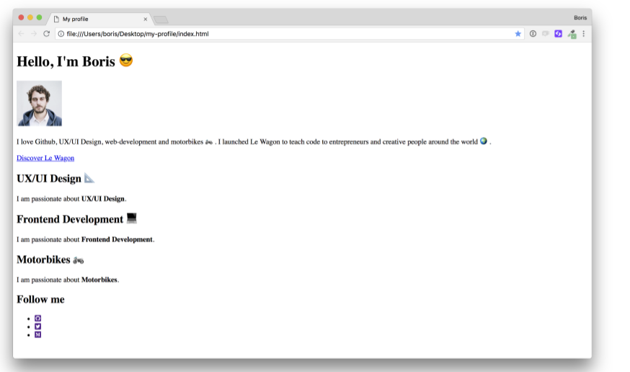
Live Code: Profile Page
Let’s make a profile page!

Slide 10
Exercise
Research different HTML tags and complete the following tasks
Create HTML table with names and email addresses of your friends. The table should have column headings
Create an HTML form where users can register with their first name, last name, email address and password
Create two pages;
A page listing your friends by name
Clicking any name should link to the person’s profile page
Find a list of 5 websites with beginner friendly content on HTML
Find out how to upload your work to Github
Notes:
Minimum is 2

Slide 11
CSS Basics

Slide 12

Adding CSS - Using The style attribute
<p style="background: red; padding: 15px; color: white">
A red box!
</p>
CSS can be added to any element using the style attribute

Slide 13

Adding CSS - Using the style tag
<style type="text/css">
p {
color: green;
}
</style>
<p>
This text will be green.
</p>
<p style="color: blue">
The style attribute
can override the green.
</p>
The <style> element can be included inside the <head> or <body> of the document, and the styles will still be applied
however it is recommended that you include your styles in the <head> for organizational purposes

Slide 14
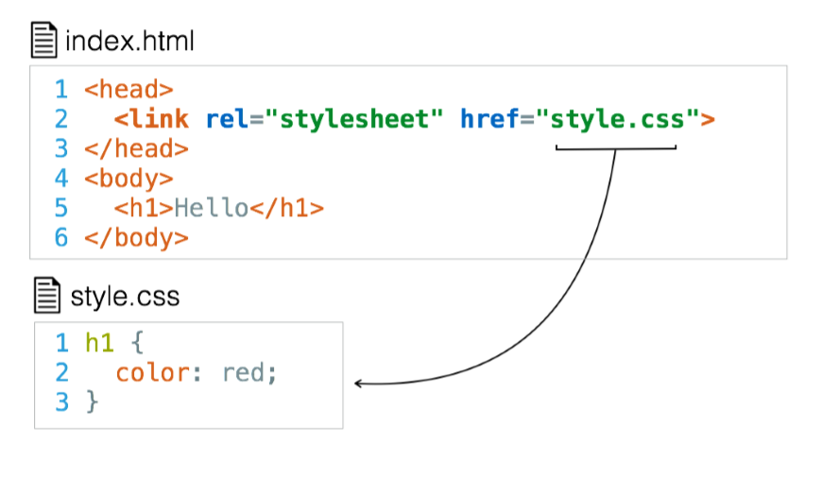
Adding CSS - Using an external stylesheet
The HTML External Resource Link element (<link>) links the current document to an external resource
It is most commonly used to link to stylesheets, but is also used to set site icons among other things

Slide 15
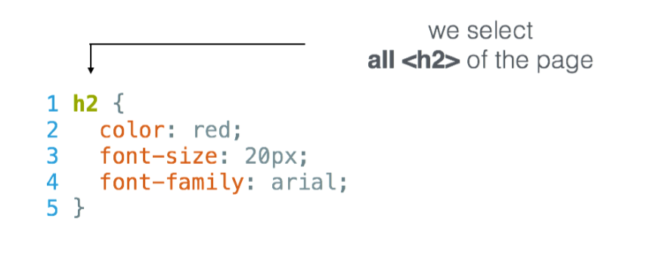
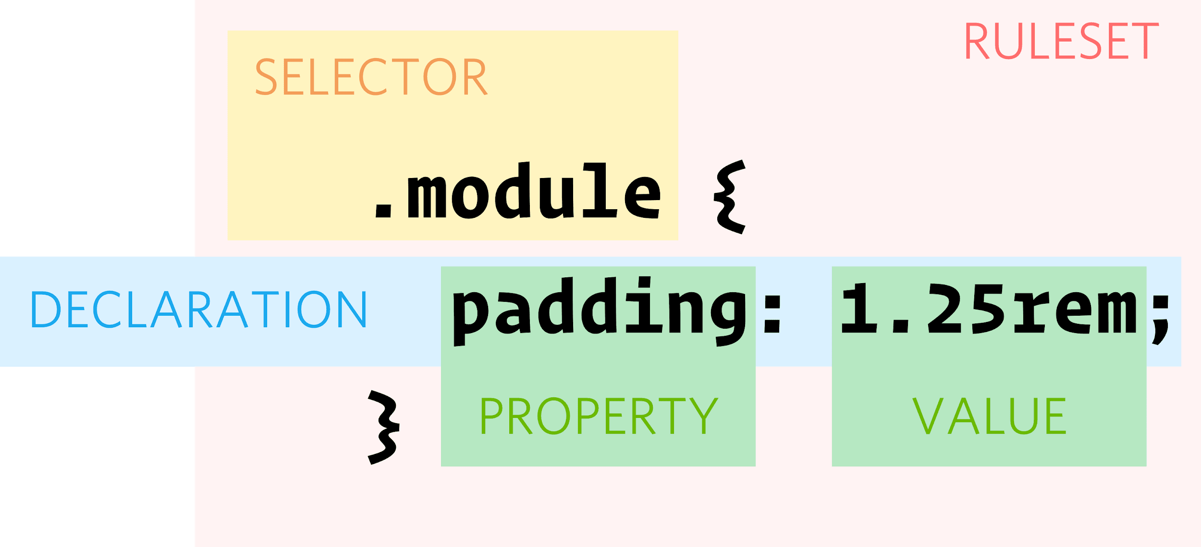
Syntax & Vocabulary

Slide 16

Exercise
Research how to add a site icon using the link element. Use your picture as an icon on your profile page from the previous class

Slide 17
CSS Selectors

Slide 18
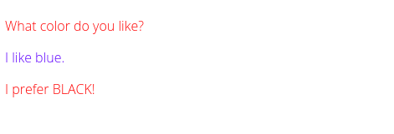
Element Selectors
<p>What color do you like?</p>
<div>I like blue.</div>
<p>I prefer BLACK!</p>
/* Make p elements are red */
p { color: red; }
/* Make div elements are blue */
div { color: blue; }
This is the simplest way to target all elements of a given type

Slide 19

Class Selectors
<ul>
<li class="first done">HTML</li>
<li class="second done">CSS</li>
<li class="third">JavaScript</li>
</ul>
/* Bold elements with the class "first" */
.first { font-weight: bold; }
/* cross elements with the class "done" */
.done { text-decoration: line-through; }
Syntax is a dot followed by a class name
A class name can be value without spaces, placed within an HTML class attribute
It’s up to you to choose a class names
Many elements can have the same class
One element can have multiple classes separated by whitespace

Slide 20
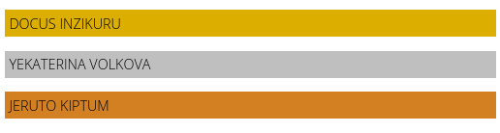
ID Selectors
<p id="first">Docus Inzikuru</p>
<p id="second">Yekaterina Volkova</p>
<p id="third">Jeruto Kiptum</p>
p {
text-transform: uppercase;
padding: 5px;
}
#first { background-color: goldenrod; }
#second { background-color: silver; }
#third { background-color: #CD7F32; }
The ID selector consists of a hash(#), followed by the ID of a given element
Any element can have a unique ID set with the id attribute.
Up to you to choose an ID name
Best way to select a single element.

Slide 21
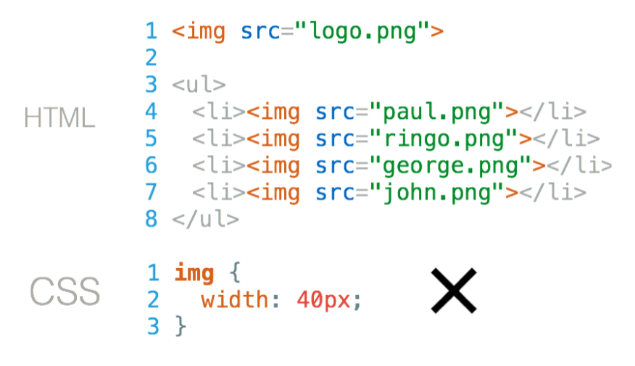
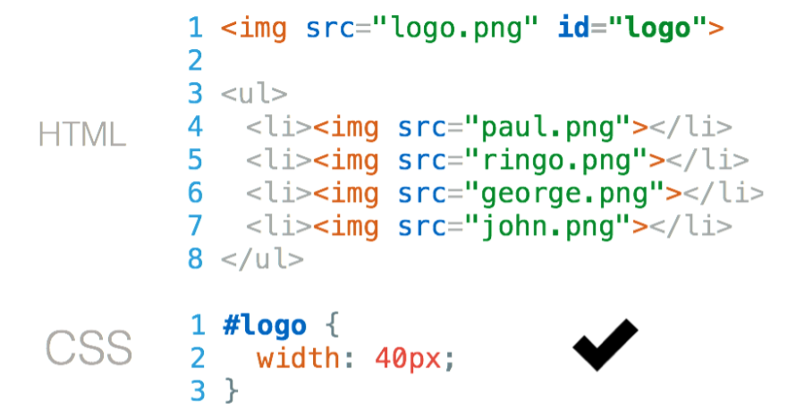
ID Selectors
How do you style logo image?
Give your tag an “id”

Slide 22
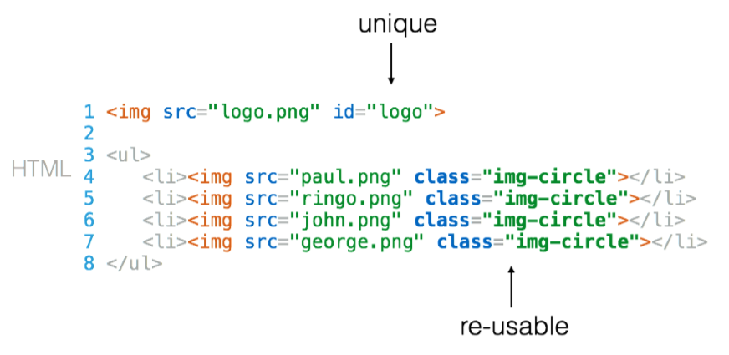
ID vs Class
Use an ID to style only one element on the page
Use a class to reuse styles on more than one element on the page

Slide 23
Exercise
Research other CSS selectors and what they do. Use the following type of selectors in your code
Element selector
ID and Class selectors
Descendant selectors
Direct descendant selectors

Slide 24
Common Style Properties

Slide 25
Text Properties
font-family: Times, serif..
Fonts - size and spacing: letter-spacing; font-size; line-height
Fonts-decoration: underline, none
Fonts-alignment: center, justify
Fonts - weight: from 100 to 900; light; bold
Google fonts
Font-Awesome
<!-- cdn link to paste in your <head> -->
<link rel="stylesheet" href="https://use.fontawesome.com/releases/v5.0.10/css/all.css">

Slide 26
Colors
Name of Color | orange, blue, purple
Hexadecimal | #FFFFFF, #ffaabb
RGB | rgb(255, 255, 255)
HSL | hsl(0, 0%, 100%)
HSV | hsv(0, 0%, 100%)
HWB | hwb(0, 100%, 0%)
CMYK | cmyk(0%, 0%, 0%, 0%)
Colors can be represented in different ways in CSS
CSS has inbuilt colors - use by name
RGB stands for Red Green Blue. Each value is between 0 and 255. For same values of R, G and B, you get a shade of grey
HSL, HSV, HWB, CMYK are rarely used, research how they work and when you can use them

Slide 27
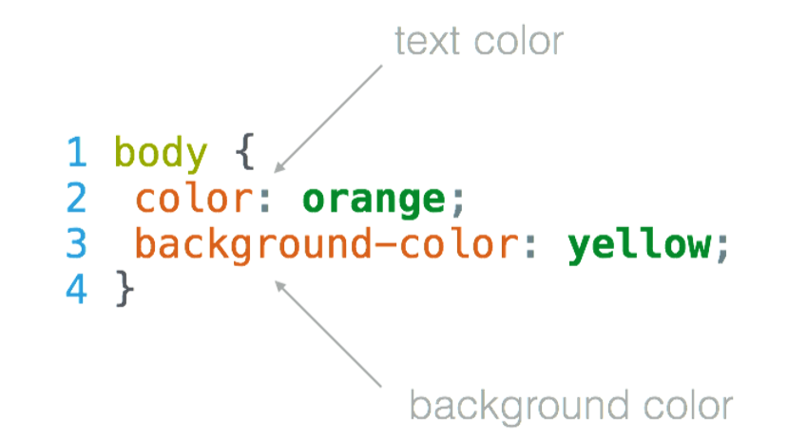
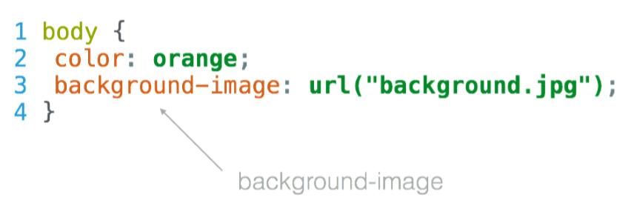
Text vs Background Color

Slide 28
Units
Unit | Description
px | Pixels are relative to the viewing device
pt | points
em | 2em means twice the size of the current font size
% | Relative to the parent element
CSS has several different units for expressing a length
Many CSS properties take "length" values, such as width, margin, padding, font-size
Length is a number followed by a length unit, such as 10px, 2em, etc
If the value is 0, the unit is not needed
For some CSS properties, negative lengths are allowed

Slide 29
Exercise
What is the difference between serif and a san-serif fonts? Get examples of both
List all units that can be used in CSS

Slide 30
CSS Box Model

Slide 31
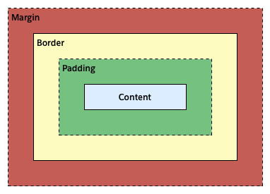
Box Model
The content area contains the "real" content of an element like text, images etc
The padding area extends from the content area to include additional space
The border area extends from the padding area to give the element a borders
The margin area extends from the border area to include an empty area used to separate the element from its neighbors

Slide 32
Width & Height
div {
border: 1px solid red;
}
/* or */
div {
border-top: 1px solid red;
border-right: 2px dotted black;
border-bottom: 1px dashed green;
border-left: 2px dotted black;
}
The height and width properties are used to set the height and width of an element.
The height and width can be set to auto (this is default - the browser calculates the height and width),
You can also specify length values, like px, cm, etc., or percent (%) of the containing block.
The max-width/min-width property is used to set the maximum/minimum width of an element. Same for height

Slide 33
Padding
div { padding: 5px; }
div { padding: 5px 10px 5px; }
div { padding: 5px 10px 5px 5px; }
div {
padding-top: 5px;
padding-right: 5px;
padding-bottom: 5px;
padding-left: 5px;
}
The CSS padding properties are used to generate space around an element's content, inside of any borders.
There are properties for setting the padding for each side of an element (top, right, bottom, and left)
To shorten the code, it is possible to specify all the padding properties in one property

Slide 34
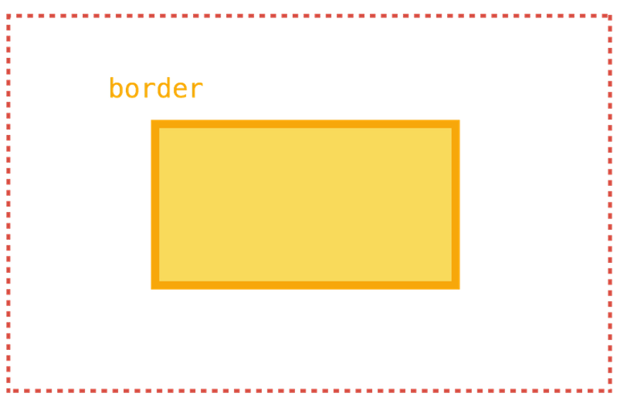
Border
div { border: 1px solid red; }
div {
border-width: 1px;
border-color: red;
border-style: solid;
}
div {
border-top: 1px solid red;
border-right: 2px dotted black;
border-bottom: 1px dashed green;
border-left: 2px dotted black;
}

Slide 35
Margin
div { margin: 5px; }
div { margin: 5px 10px 5px; }
div { margin: 5px 10px 5px 5px; }
div {
margin-top: 5px;
margin-right: 5px;
margin-bottom: 5px;
margin-left: 5px;
}
The CSS margin properties are used to create space around elements, outside of any defined borders
There are properties for setting the margin for each side of an element (top, right, bottom, and left)
To shorten the code, it is possible to specify all the margin properties in one property

Slide 36
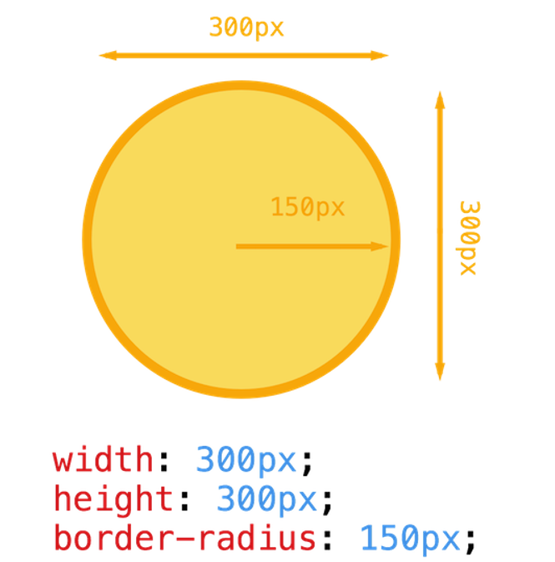
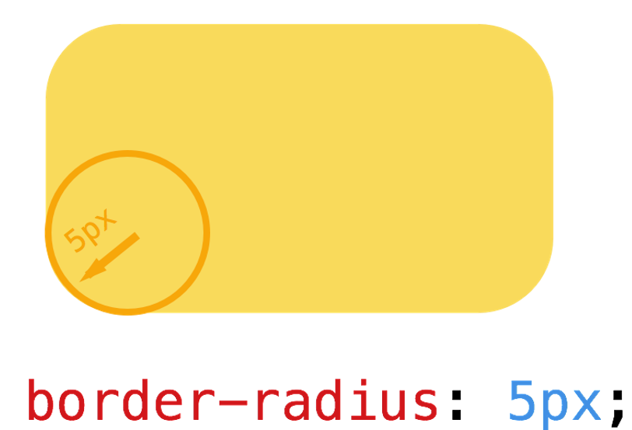
Border Radius

Slide 37
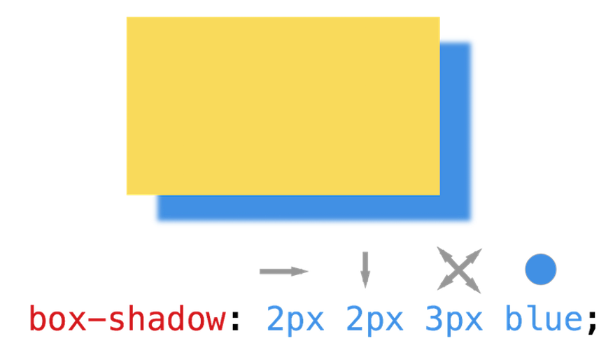
Box Shadow
/* Absolute */ p { width: 50px; }
/* Relative to parent */ p { width: 50%; }
/* Relative to font size */ p { width: 2em; }

Slide 38
CSS – Div Design Tips
/* White background */
background: white;
/* Internal space */
padding: 30px;
/* Small radius */
border-radius: 4px;
/* Light shadow */
box-shadow: 0 10px 30px rgba(0,0,0,.1);
/* Set the width */
width: 300px;
/* Set automatic margins on right/left */
margin: 0 auto;

Slide 39
Pseudo Classes
/* Button turns blue pointed at*/
button:hover { color: blue; }
/* Visited links turn green */
a:visited { color: green; }
/* First paragraph is bigger */
p:first-child { font-size: 1.2em; }
A pseudo-class is a keyword added to a selector that specifies a special state of the selected element.
For example, :hover can be used to change a button's color when the user's pointer hovers over it
With pseudo-classes you can style an element in relation to external factors

Slide 40
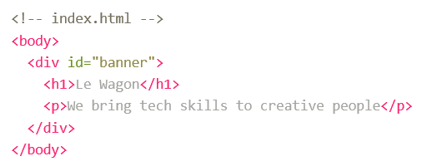
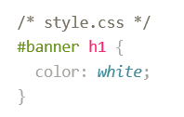
Descendant Selectors
h1 children of the element id="banner" will be white
combined with

Slide 41
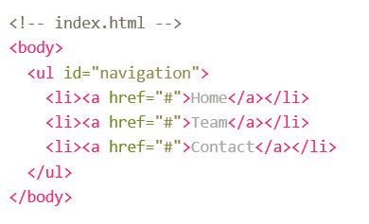
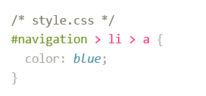
Direct Descendant
a elements which are direct children of li elements direct children of id="navigation" will be blue.
combined with

Slide 42
Quizz

Slide 43
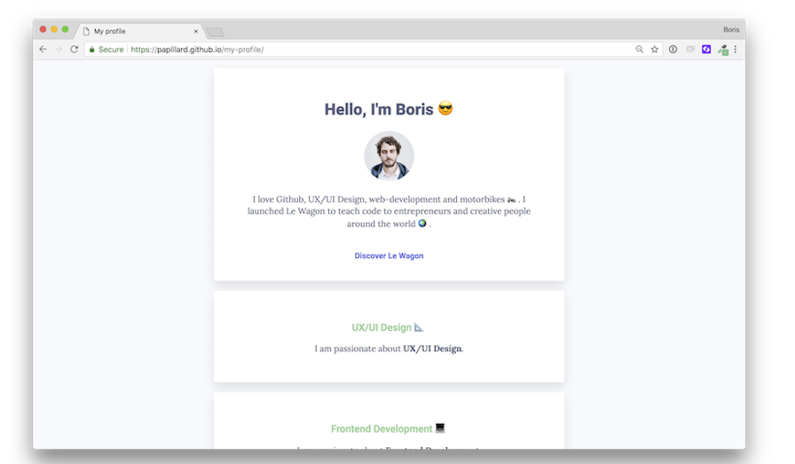
Live-Code - Profile Page 2
Let's ﬁnish our live-code and get this ﬁnal result!

Slide 44
Resources
Guides/References
“A reference guide to the many features of CSS” - https://css-tricks.com/almanac/
HTML Dog - https://htmldog.com/guides/html/beginner
Web design blogs
Smashing Magazine

Slide 45
Disclaimer
This material was prepared using Le Wagon resources and shall not be used outside the context of ETC Coding.

